Slide 1
Social buzz
Siddhant Gidde

Slide 2
AGENDA
Project Recap​
Problem
The Analytics Team
Process
Insights
Dashboard

Slide 3
Project Recap
Project Scope:
Our engagement with Social Buzz will commence with a 3-month initial project designed to demonstrate our capabilities. The client's expectations for this phase include:
Audit of Big Data Practice:
To conduct a comprehensive audit of Social Buzz's big data practices, examining data collection, storage, processing, and analytics. This audit aims to identify areas for optimization, cost reduction, and performance enhancement.
2. Recommendations for a Successful IPO:
To provide strategic recommendations and guidance to ensure a successful IPO. This will encompass compliance, financial readiness, risk assessment, and a roadmap to navigate the complexities of going public.
3. Content Category Analysis:
To analyze Social Buzz's content categories to identify the top 5 categories with the largest aggregate popularity. This analysis will provide insights into user preferences and trends, aiding content curation and strategy.

Slide 4
PROBLEM
The specific problem for Social Buzz when requesting an analysis of their content categories to identify the top 5 categories with the largest aggregate popularity.
Social Buzz, despite its impressive growth, lacked a comprehensive understanding of which content categories were resonating most strongly with its user base.
But how to capitalize on it when there is so much?
The analysis aimed to deliver concrete insights into the top 5 content categories with the largest aggregate popularity on Social Buzz.

Slide 5



The Analytics Team
ANDREW FLEMING
Marcus Rompton
Siddhant gidde
Chief Technical Architect
Senior Principle
Data Analyst

Slide 6
Process
Data understanding
Data CLEANING
Data modelling
Data analysis
Data visualization
Understanding the Project scope
Cleaning and Processing Datasets in Microsoft Power Query Editor
Building Relationship in Microsoft Power BI
Developing Dashboard in Microsoft power BI
Visualizing live Data in Microsoft Power Point

Slide 7
INSIGHTS
Social Buzz

Slide 8
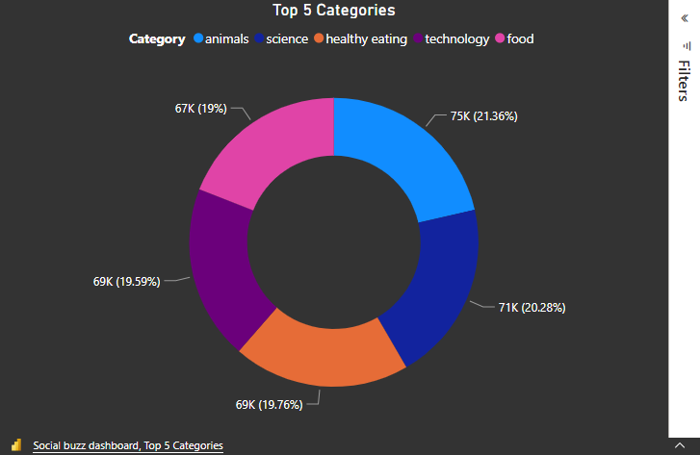
TOP 5 CATEGORIES

Slide 9
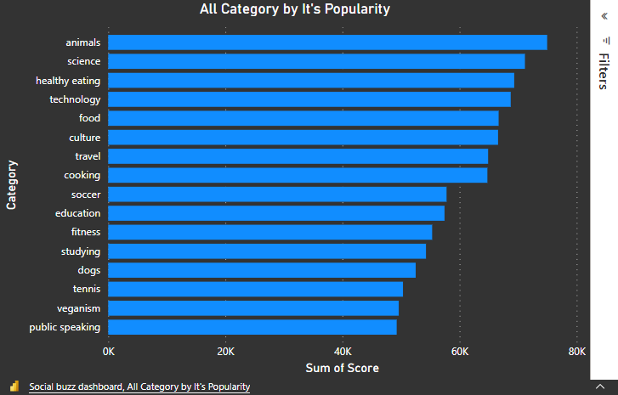
All category by popularity

Slide 10
Dashboard
Social Buzz

Slide 11
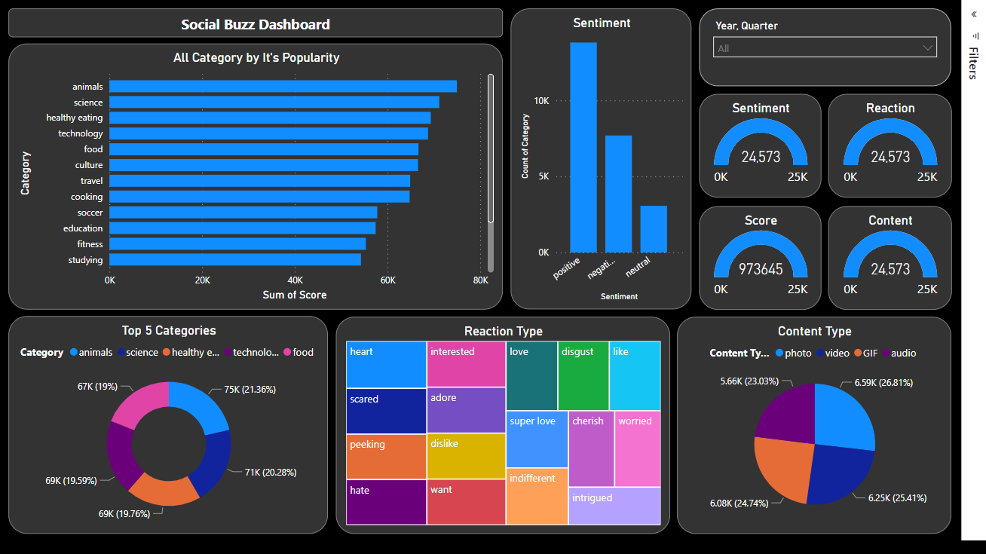

Slide 12
THANK YOU

